Slide 1
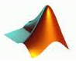




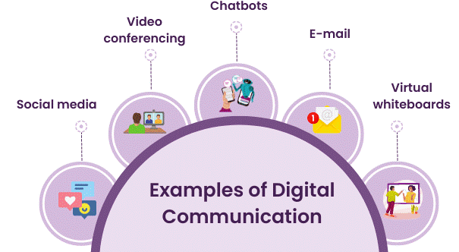


DIGITAL COMMUNICATIONS
Course Code: 23EC2208A
Dr. G V Subbarao
Department of Electronics and Communications Engineering
K L E F Deemed to be University

Slide 2
SYLLABUS
(Content Prepared by Dr. M. Venugopala Rao, CC)
Pulse Modulation Techniques: Baseband signals. Sampling process; Concepts on PAM, PWM and PPM. Quantization Process; Quantization Noise; Linear and Non-linear PCM codes, Noise Considerations in PCM Systems; PCM Line Speed, DPCM, Delta Modulation (DM) and Adaptive DM. Line codes.
Transmission Through Bandlimited Channels: Characterization of Band limited Channels, Optimum Receiver for the AWGN Channel, Detection of Baseband Signals in Noise, Matched filter, Other binary signal transmission and antipodal signals., Line Coding; The Power Spectrum of a Digital PAM Signal, Inter symbol Interference: Eye diagrams, System Design for Band limited Channels. Raised Cosine spectrum, Linear and non-linear Equalizers.
Digital Transmission via Carrier Modulation: Concepts on measure of Information: Bits, Bit Rate, Baud, and M-ary Encoding; Noiseless coding-Huffman coding, Channel capacity, ASK, PSK, FSK, QAM. Bandwidth Efficiency, Carrier and Clock Recovery, Probability of Error and Bit Error Rate, Error Performance.
Spread Spectrum Modulation: Pseudo-noise sequences, notion of spread spectrum, Direct Sequence Spread Spectrum (DSSS) with coherent BPSK, Signal space, dimensionality and processing gain, Probability error and Frequency-Hop Spread Spectrum.

Slide 3
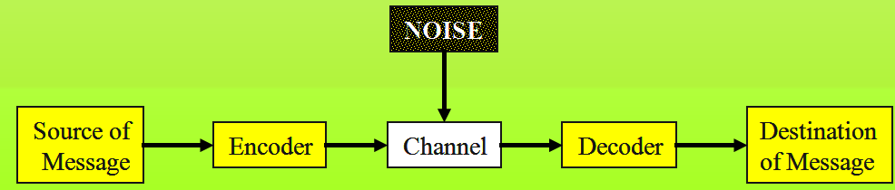
Introduction to Information Theory
Information theory is a branch of science that deals with the analysis of a communications system.
Claude Shannon Published a landmark paper in 1948 that was the beginning of the branch of information theory.
We are interested in communicating information from a source to a destination

Slide 4

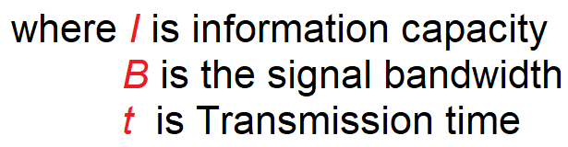
Information Theory
Information theory is a highly theoretical study of the efficient use of bandwidth to propagate information through electronic communications systems (Channel or mediam).
Information theory can be used to determine the information capacity of a data communication system.
Information capacity is a measure of how much information can be propagated through a communications system and is a function of bandwidth and transmission time.

Slide 5
Information capacity represents the number of independent symbols that can be carried through a system in a given unit of time.
The most basic digital symbol used to represent information is the binary digit, or bit.
Therefore, it is often convenient to express the information capacity of a system as a bit rate.
Bit rate is simply the number of bits transmitted during one second and is expressed in bits per second (bps).
The information capacity is a linear function of bandwidth and transmission time and is directly proportional to both. If either the bandwidth or the transmission time changes, proportional change occurs directly in the information capacity.

Slide 6

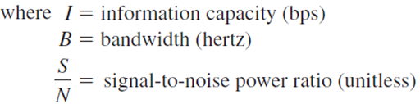
The Shannon limit theorem:
The higher the signal- to-noise ratio, the better the performance and the higher the information capacity.

Slide 7
End

